Slide 1
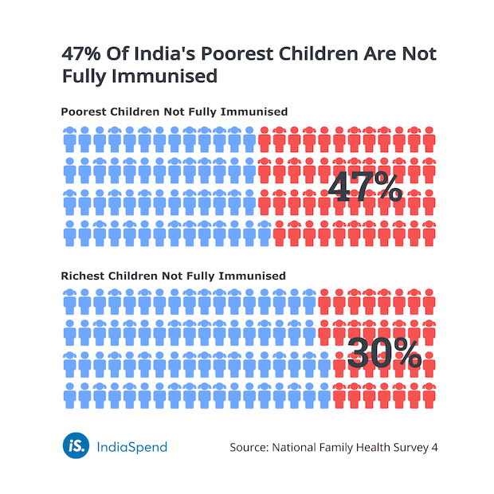
Influencing Inequality through Immunization
Key Points
Vaccine inequity, specifically in terms of vaccine access and utilization, is a key issue in India.
Creating a long-term immunization program by using the principles of incentivisation may be a possible solution.
Education and communication around the benefits of immunization are most effective when delivered through a recognizable and esteemed human connection.
Ensure access to vaccines through proper infrastructure through mobile clinics and other interventions
Group 3: Jane Shambare, Miranda Nonikashvili, Sanket Sen, Laura Chambers, Hajar Idrissi, Monica Beeder, Amalie Moxness Reksten & Tolulope Aworefa.

Slide 2
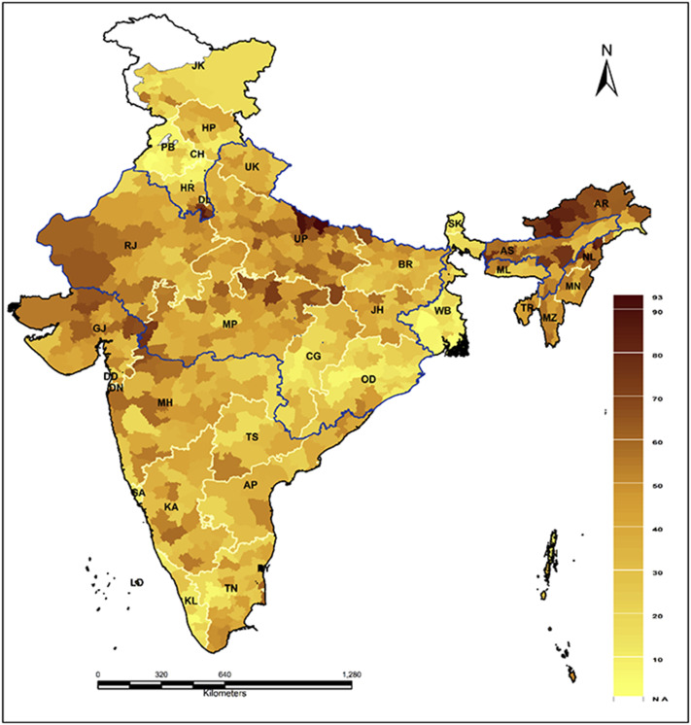
Problem statement
The global community agreed to reach all children with immunization services in the form of the 2030 Agenda for Sustainable Development. However, vaccine inequity is a key issue across the region, especially for children.
Important statistics
Resources and wealth
Contributing factors
Communication
The impact of COVID-19
Distribution of full immunization coverage gap by the districts of India
Notes:
Jane & Miranda
The global community agreed to reach all children with immunization services in the form of the 2030 Agenda for Sustainable Development (United Nations, 2015). However, vaccine inequity, specifically in terms of vaccine access and utilization, are key issues across the region, especially for children.
Important Statistics: 1 in 5 children do not receive the vaccines they need
1.5 million children die each year from vaccine-preventable diseases.
Resources and Wealth: resources are not being distributed optimally.
This is not only an issue in wealthy countries.
Vaccine inequity is a growing challenge for immunization programs.
Resources are not being distributed optimally.
Contributing Factors:
Concerns about safety; negative beliefs based on myths; misinformation; mistrust in the government, health system, or health professionals; costs; and influentials in society.
Communication:
Effective communication: is key to addressing the concerns and fears surrounding vaccine hesitancy
The Impact of Covid -19:
UNICEF (2022) India topped the countries where routine immunisation has declined as a result of the COVID-19 pandemic, with more than 3.5 million unprotected children and increased capacity issues within the health system.

Slide 3
RECOMMENDED STRATEGIES
Multidimensional mmm-Matrix
Macro
INFRASTRUCTURE
Three recommended strategies classified according to the mmm-Matrix
Meso
SOCIAL AMBASSADORS
Micro
STEP-WISE INCENTIVIZATION PROGRAM
Notes:
Sanket
Keeping in mind the problem of immunization inequity faced by Indian children, we have made three major recommendations. These three recommendations have been classified in terms of the Mmm matrix.
Starting with the micro level, we suggest a step-wise incentivization program.
Then at the meso and macro level, we recommend a program of using social ambassadors.
Finally at the macro level, we suggest having a strong infrastructure to ensure that vaccines are made accessible

Slide 4
RECOMMENDED STRATEGIES
Micro Solution – Incentivization Program
Step-wise incentive program designed to reward both short- and long-term behaviour.
Since most immunization programs require more than one dose, there can be a small incentive (e.g. groceries) on getting the first dose, and a promise of a larger incentive (e.g. groceries and kitchen utensils) if they come for the second dose.
The incentives do not need to be universal, and should be localized according to the local traditions and norms. However, each incentive should fulfil the three criteria of good incentive (certain, upfront and valued)
Long-term program. Better incentives as you move along the immunization program.
Notes:
Monica

Slide 5
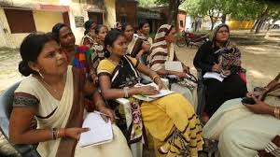
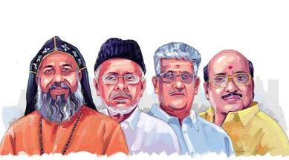
3 Tiers of Ambassadors
Meso Solution:
The Power of Social Connection
1. Neighbours Helping Neighbours
A Pyramid of Ambassadors
2. Community Leaders
Trained personnel from UNICEF will reach out to different communities to recruit ambassadors who would be educated on childhood immunization. These ambassadors will then be tasked with the promotion of the “Immunization Incentivization Program” within their unique spheres of connection.
3. Bollywood Celebrities
Notes:
Laura: for our Meso solution we are recommending to utilize the power of Social Connection through a pyramid of social ambassadors. Trained personnel from UNICEF will reach out to different communities to recruit (either voluntarily or as a paid collaboration) ambassadors who would then be educated on childhood immunization ( themes such as their importance, benefits and safety). These ambassadors will then be tasked with the promotion the “Immunization Incentivization Program” within their unique spheres of connection.
3 Tiers of Ambassadors
1. Local level : Individuals from vulnerable communities themselves will be engaged each ambassador is assigned to 5 local families and tasked with educating them on the program. This would be modeled on the Swacchagrahi strategy. Ambassadors would also report to back to UNCIEF qualitative information on the barriers to access these communities are identifying.
2. At the next level of influence community leaders such as religious leaders, teachers, doctors) would be provided through UNICEF the resources needed to be educated on and promote the immunization program within their communities.
3.At the final level: Bollywood is a national phenomenon in India. Each state has a Bollywood celebrity who is the “face” of that state. These celebrities would be educated and engaged to promote the program on their social media and other platforms of choice. This promotion would also include information on when and where the mobile clinics will be Precedent for the use of type of influencing to impact areas such as politics, and stimulating the local economy has been previously established in India (https://scroll.in/video/1008455/watch-shah-rukh-khan-and-some-ai-star-in-cadburys-diwali-ad-promoting-hyperlocal-businesses
Photo Credits:
Bollywood Image: Stock Photo Image https://www.shutterstock.com/search/bollywood:

Slide 6
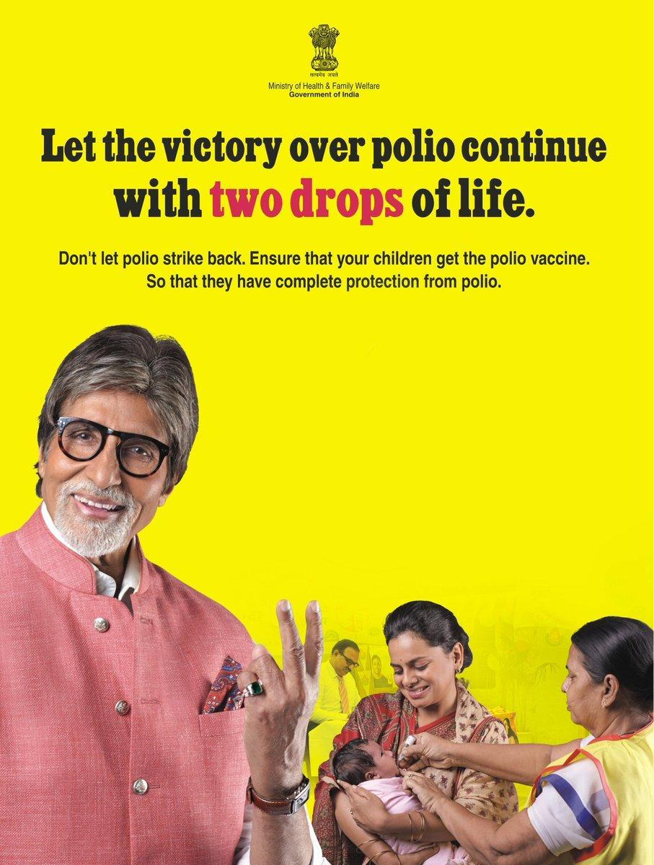
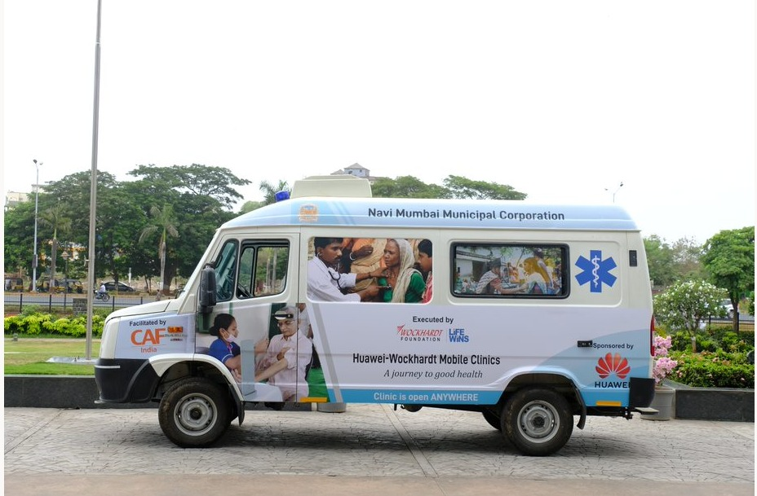
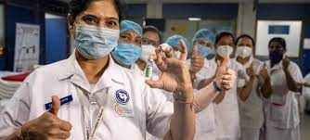
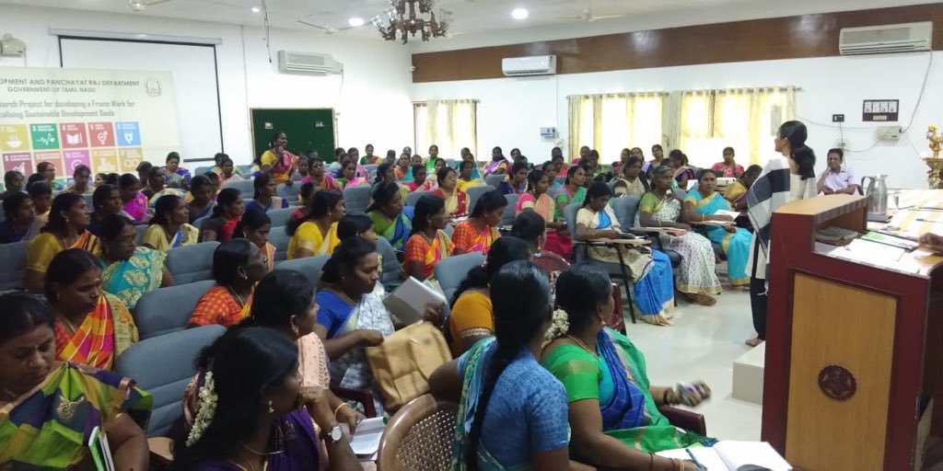
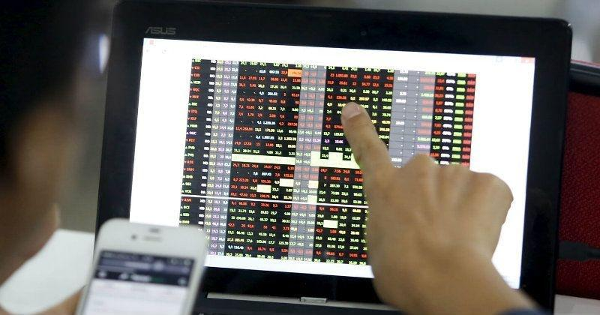
Macro solutions
RECOMMENDED STRATEGIES
Macro Solution – Infrastructure
Use the national media and social ambassadors to advertise for the campaign as well as raise awareness of the importance of vaccines;
Availability of vaccines at a minimal cost;
Arrange mobile clinics with cold storage facilities to reach people in remote areas;
Establish a good data system;
Organize national vaccination campaigns that moves across cities;
Provide training programs on vaccination for healthcare personnel.
Notes:
Hajar
Availability of vaccines at a minimal cost for the beneficiaries.
Arrange mobile clinics with cold storage facilities to reach people in remote areas
Establish a good data system to identify and follow up children vaccination.
Organize national vaccination campaigns that moves across cities.
Use the national media to advertise for the campaign as well as raise awareness of the importance of vaccines.
Provide training programs on vaccination for healthcare personnel.

