Slide 1
Reducing child poverty through child education
South Africa
Group 10

Slide 2
Multidimensional and Intergenerational Child Poverty:
68,3%
Multidimensional poverty
of children experiencing multidimensional poverty are Black African
Intergenerational problem
Primary focus: Education
Notes:
A child is considered multidimensionally poor if he/she is deprived in 3 or more out of the 7 dimensions of well-being (WASH, Housing, Nutrition, Protection, Health, Information, Child Development and Education). According to Statistics South Africa (Stat SA) 68,3% of children experiencing multidimensional poverty in South Africa are Black African. Moreover, for Black South African children the problem is also intergenerational. That is a problem that has been passed on from generation to generation in South Africa. Among possible solutions to address this problem as an intergenerational issue are policies addressing housing conditions, jobs, and education.
The outputs of education are often connected to higher incomes associated with each additional year of education (Modisaotsile, 2012). Although enrolment has increased, completion of schooling has been identified as a significant problem (Birdsall et al., 2005). A focus on access and completion of education in our policy recommendations thus increases the chances of employment and transitioning out of poverty for children in the long term (Barnes et al., 2017).

Slide 3
The challenges children face in accessing and completing education
Access
Safety issues
School drop out 60% of learners drop out before completing secondary school (increased during the COVID-19 pandemic)
Teenage pregnancy
Alcohol and substance abuse
Income issues
Perceived value of education
Lack of involvement from parents
Low motivation of the children to attend school
Teacher training
Notes:
There are two main issues that children face with regards to education, (1) access and (2) completion of the educational program. The poor access to education is especially true for children living in rural areas of South Africa. Additionally, safety is another problem that might hinder children from getting to school.
However, even when children have access to the school system, 60% of the learners drop out before completing secondary education and there are several reasons for this. Learners become pregnant, there is abuse of alcohol and other substances, insufficient income for the household might lead some children to voluntarily take a job and leave school.
Additional issues, indirectly connected to our policy recommendations, involve the perceived value of education by several actors, such as the lack of involvement from parents, a prescriptive curriculum that may lead to lower motivation with the children and the financial resources assigned to teacher salaries and in-service training.

Slide 4
How can we address the difficulty to access school?
Nomad schools
In order to make it easier for these children in distant areas to access schools, as a short-term solution, we suggest the creation of nomad schools, that would meet the kids in their neighborhoods, instead of forcing them to endure long trips to arrive at schools.
As a long-term solution, we could consider a combination of nomad schools and distance learning. Important services that nomad schools will be able to offer:
Healthy decent meals,
Address content that is relevant to that community,
Address sexual education,
Focus on both critical thinking to develop citizens able to demand their rights, and practical skills helpful to have a source of livelihood.
Notes:
The term ‘Nomad’ schools in this context means the non-formal form of education that will be provided for children without access to formal schooling and those in marginalised communities.

Slide 5
How can we address the difficulties of staying in school?
In order to incentivize children to stay in school for a longer period of time, we suggest:
Including sex education in their program (to reach both the children and the parents);
Create a well-regulated service-learning program, in which kids would be financially compensated for doing internships in their community that would be part of the more practical aspects of their education (it is NOT child labor);
Making the schools welcoming for parents to participate, implementing for example a program where their pieces of knowledge are treated as valuable and they are invited to share them with the kids.
Notes:
Clarification: We are NOT suggesting that the internship programs would substitute the grant programs, but instead complement it.
It is a reality in South Africa that many kids do work. The internship program would be offered as an alternative to incentivize them to choose education over a source of income. The internship program is part of their education.

Slide 6
Well regulated service learning program
The program focuses on education and NOT on child labor as it makes explicit connections with the curriculum;
It is not a substitute for the grants program, but a complementary solution;
It is important that this program would be well regulated to avoid the exploitation of the kids
If implemented right this service learning program could contribute to reform education in order to make it more relatable to real life and thus more meaningful to the students and their parents.
The program is optional.

Slide 7
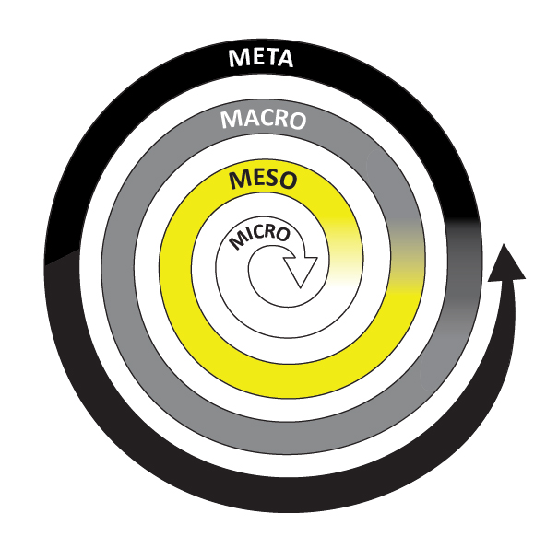
Conclusion
In order to address child poverty in South Africa, we recommend
creating short-term nomad schools to facilitate access to schools
creating optional, paid service-learning programs to incentivize completion of education until grade 12
including survival skills (Entrepreneurial skills) in the school curriculum
Notes:
Our policy recommendations address the individual learners, especially those left behind in the formal educational system of South Africa. They form the center of our recommendations, with impacts reaching beyond the micro level. Through the nomad schools and the service-learning programs, the communities in rural areas are connected through the children. As we envision the service-learning programs being connected to the newly implemented survival skills subject, children not only learn about the communities they are part, there is an intergenerational knowledge exchange happening. The kind of knowledge and skills we envision the students will be learning should be locally determined depended on the needs of the community. These might include, for instance, learning to grow vegetables and fruit by helping out on local farms, learning technological skills at a local hotel or lodge, helping out in the kitchen learning how to cook, etc. As such, we also see benefits that will improve the national conditions of the conditions as these recommendations can be applied in different local contexts throughout the country. Furthermore, by adapting and tailoring the educational program of children in rural areas to their local communities, we are thinking globally, with benefits for the children, their communities, their country and their world.

Slide 8
Thank
You!

Slide 9
References
Barnes, H., Hall, K., Sambu, W., Wright, G., & Zembe-Mkabile, W. (2017). Review of research evidence on child poverty in South Africa. http://childrencount.uct.ac.za/uploads/publications/Policy_Brief_Review%20of%20research%20evidence%20on%20child%20poverty%20in%20South%20Africa.pdf
Birdsall, N., Levine, R., & Ibrahim, A. (2005). Towards Universal Primary Education: investments, incentives, and institutions. European Journal of Education Research, Development, and Policy, (40)3, 337-349. https://doi.org/10.1111/j.1465-3435.2005.00230.x
Modisaotsile, B. M. (2012). The Failing Standard of Basic Education in South Africa. In AISA Policy Briefs (72). http://www.ai.org.za/wp-content/uploads/downloads/2012/03/No.-72.The-Failing-Standard-of-Basic-Education-in-South-Africa1.pdf
Mokoena, P., & van Breda, A. D. (2021). School dropout among female learners in rural Mpumalanga, South Africa. South African Journal of Education, 41(3).
O’Brien, F. (2005). Grounding service learning in South Africa. Acta Academica Supplementum, 3, 64-98. https://scholar.ufs.ac.za/bitstream/handle/11660/9803/academ_supp3_2005_a4.pdf?sequence=1&isAllowed=y
Save the children. (2021). Teen pregnancies in South Africa jump 60% during COVID-19 pandemic. https://reliefweb.int/report/south-africa/teen-pregnancies-south-africa-jump-60-during-covid-19-pandemic#:~:text=New%20figures%20from%20the%20Gauteng,same%20period%20a%20year%20earlier.
UNICEF. (2020). Child Poverty in South Africa: A Multiple Overlapping Deprivation Analysis. Summary. https://www.unicef.org/southafrica/media/4241/file/ZAF-multidimensional-child-poverty-analysis-policy-brief-07July-2020.pdf
Willan, S. (2013). A review of teenage pregnancy in South Africa – experiences of schooling, and knowledge and access to sexual and reproductive health services. https://healtheducationresources.unesco.org/fr/library/documents/review-teenage-pregnancy-south-africa-experiences-schooling-and-knowledge-and

